Slide 1

MINI PROJECT PRESENTATION
DEPARTMENT OF COMPUTER APPLICATIONS BHARATHIAR UNIVERSITY COIMBATORE DECEMBER - 2022

Slide 2

WASTE DETECTION AND CLASSIFICATION USING DETECTRON2
PRESENTED BY
SENTHIL KUMAR N (21CSEG31)
II – M.Sc., DATA ANALYTICS
BHARATHIAR UNIVERSITY

Slide 3


OBJECTIVE
. The project aims to create an automated waste detection system using “Detectron2”, a next-generation open-source object detection system from Facebook Artificial Intelligence Research (FAIR), that will gather the waste images taken from a camera with instance segmentation, detection & prediction, and categorize the waste materials into 60 categories so that the waste can be properly dumped in the recyclable and non-recyclable type.

Slide 4



WHY DETECTRON2?
01
02
03
The platform is now implemented in PyTorch
Flexible & Extensible
Able to provide fast training on single or multiple GPU servers

Slide 5
Fig.1 Detectron2’s generalized RCNN Framework

Slide 6
OBJECT DETECTION
Object Detection is a part of the Computer Vision (CV) technique, where a software framework can detect, trace, and locate the object from any given video or image.
One of the special traits of object detection is that it recognizes the object's class (for instance, person, table, chair, and so forth) and the coordinates of the location of the object in the given picture.
By drawing a bounding box around the object, it states that the region is being pointed out. The bounding box might or might not precisely find the location of the object.

Slide 7
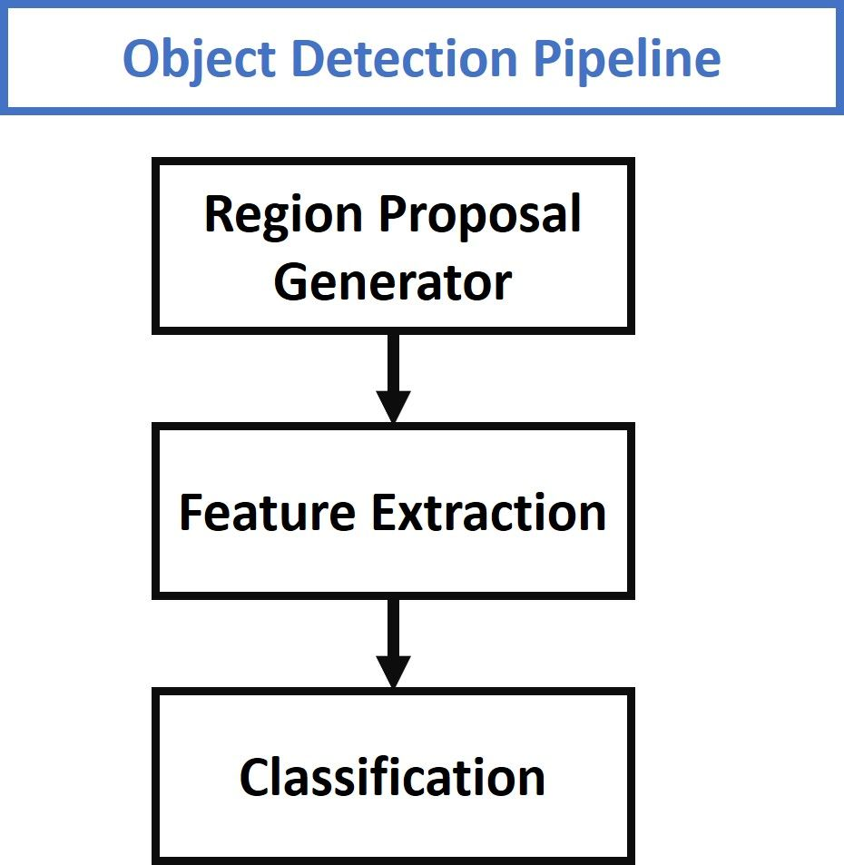
Fig.2 General Object Detection Pipeline

Slide 8
CNN
A Convolutional Neural Network (CNN) is a type of artificial neural network used in image recognition and processing that is optimized to process pixel data. Therefore, Convolutional Neural Networks are the fundamental and basic building blocks for the computer vision task of image segmentation (CNN segmentation)
It consists of three main layers:
1. Convolutional Layer
2. Pooling Layer
3. Fully Connected Layer

Slide 9
Fig.3 Basic CNN Architecture

Slide 10
R-CNN
R-CNN or RCNN, stands for “Region-Based Convolutional Neural Network”, it is a type of machine learning model that is used for computer vision tasks, specifically for object detection.
It first extracts many (e.g., 2000) region proposals from the input image (e.g., anchor boxes can also be considered as region proposals), labeling their classes and bounding boxes (e.g., offsets).

Slide 11
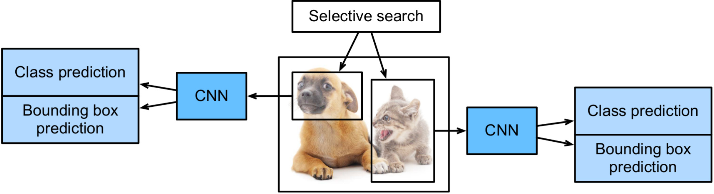
Fig.4, R-CNN Model

Slide 12
FASTER R-CNN
To reduce region proposals without loss of accuracy, the faster R-CNN proposes to replace selective search with a region proposal network
It is an extension of Fast R-CNN. As its name suggests, Faster R-CNN is faster than Fast R-CNN thanks to the region proposal network (RPN).

Slide 13
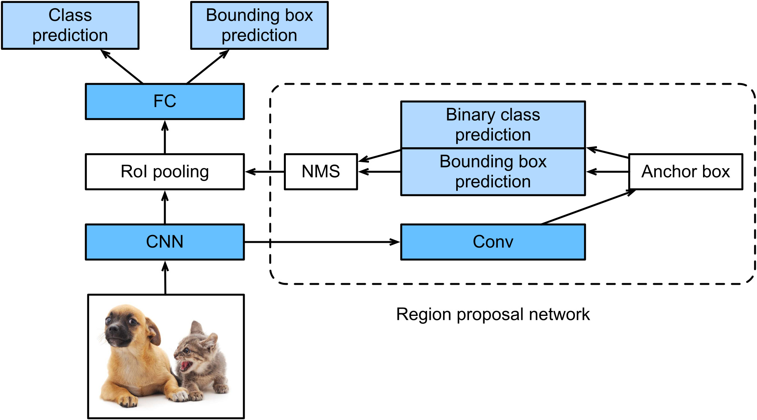
Fig.5, Faster R-CNN Model

Slide 14
MASK R-CNN
Mask R-CNN, or Mask RCNN, is a Convolutional Neural Network and state-of-the-art in terms of image segmentation and instance segmentation.
It was developed on top of Faster R-CNN, and R-CNN.
There are 2 main types of image segmentation that fall under Mask R-CNN:
Semantic Segmentation
Instance Segmentation

Slide 15
Fig.6, Semantic VS Instance Segmentation

Slide 16
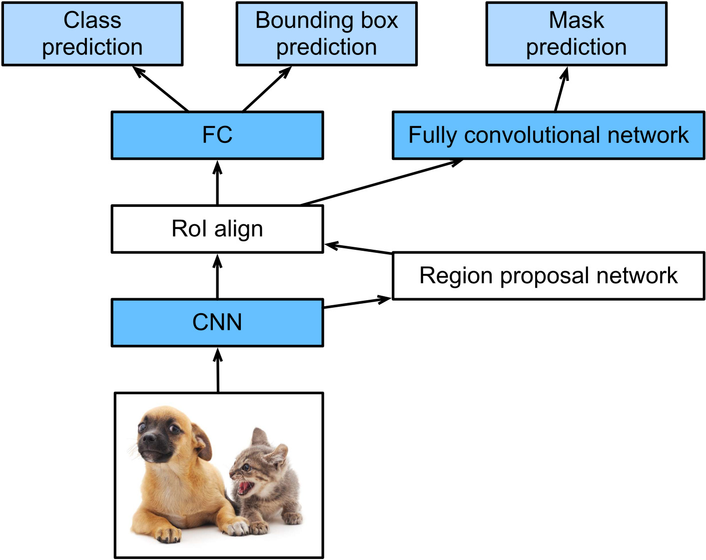
Fig.7, Mask R-CNN Model

Slide 17
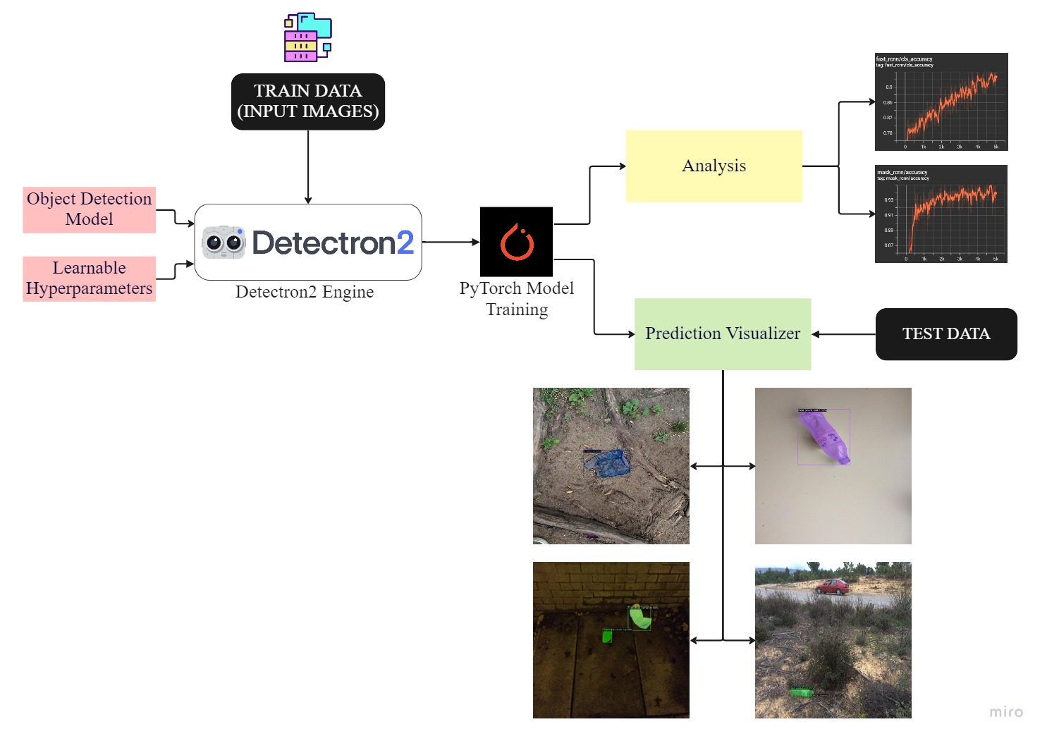
Fig.8, Mechanism of Object Detection in Detectron2

Slide 18
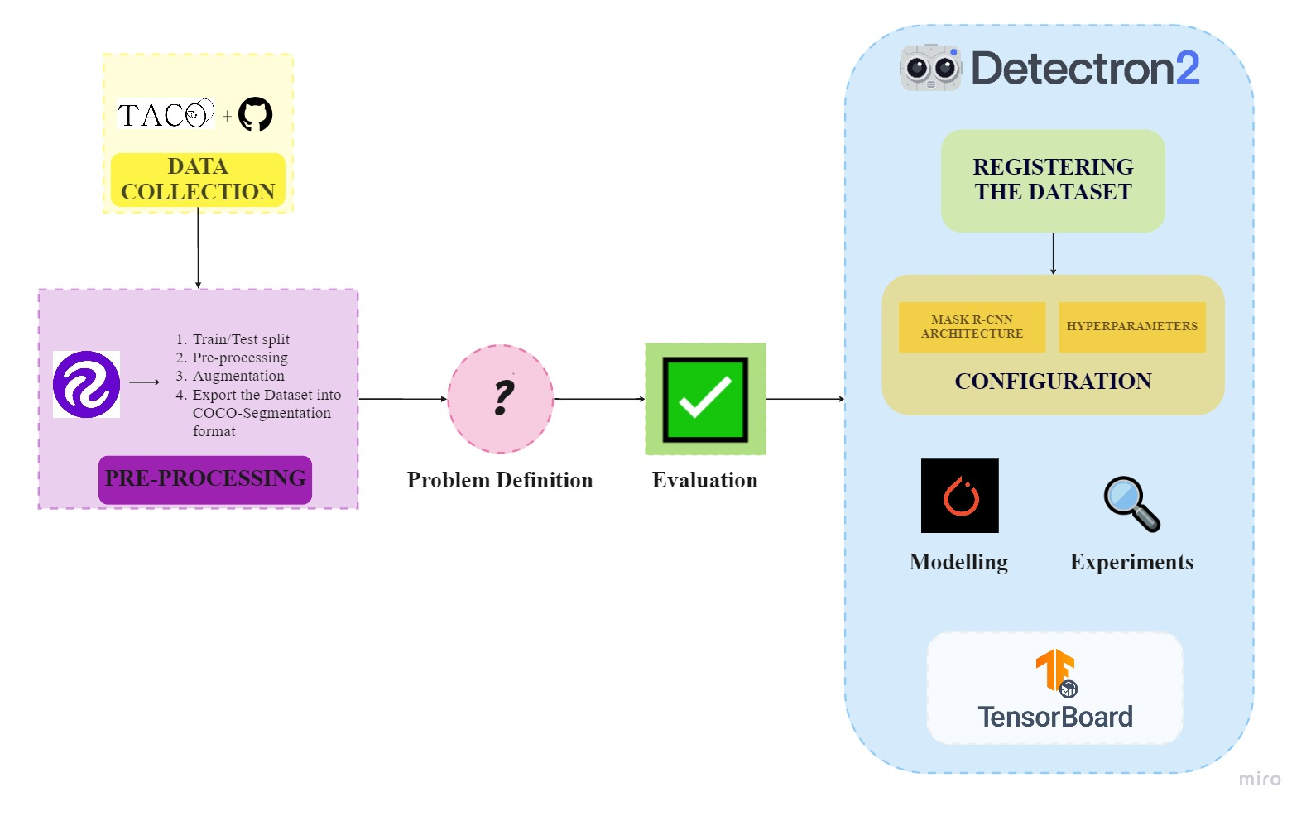
PROCESS FLOW DIAGRAM

Slide 19
SOFTWARE USED
PYTHON – 3.8.16
GOOGLE DRIVE
ROBOFLOW
GOOGLE COLABORATORY (COLAB)
COMPUTE UNIFIED DEVICE ARCHITECTURE (CUDA)
TENSORBOARD

Slide 20
PACKAGES USED
detectron2 (0.6)
torch (1.13.0+cu116)
torchvision (0.14.0+cu116)
cuda – cu116
opencv-python (4.6.0.66)
roboflow (0.2.21)
pip (21.1.3)
pycocotools (2.0.6)
Pillow (7.1.2)
Matplotlib (3.2.2)
TensorBoard (2.9.1)
pandas (1.3.5)
numpy (1.21.6)
glob (0.7)
json (4.3.3)
tqdm (4.64.1)

Slide 21
DATA COLLECTION
In the online GitHub Repository, the open image dataset called Trash Annotations in Context (TACO) by the authors Pedro F Proença and Pedro Simões was downloadable as zip file which was mainly used in the classification of wastes which was found in the wild and the annotations are in COCO format.
It contains photos of litter taken under diverse environments, from tropical beaches to London streets. These images are manually labeled and segmented according to a hierarchical taxonomy to train and evaluate object detection algorithms.

Slide 22
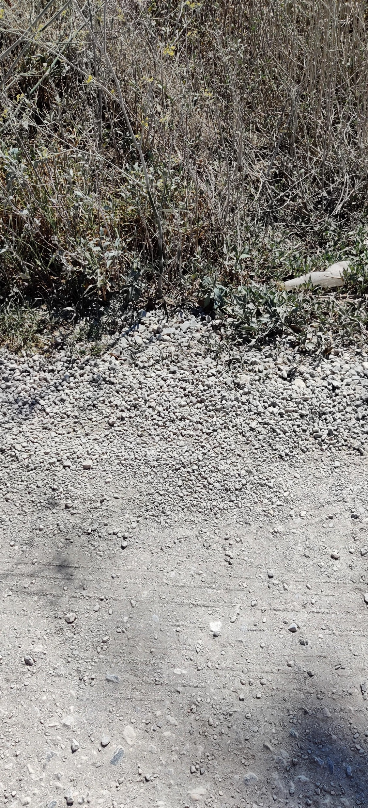
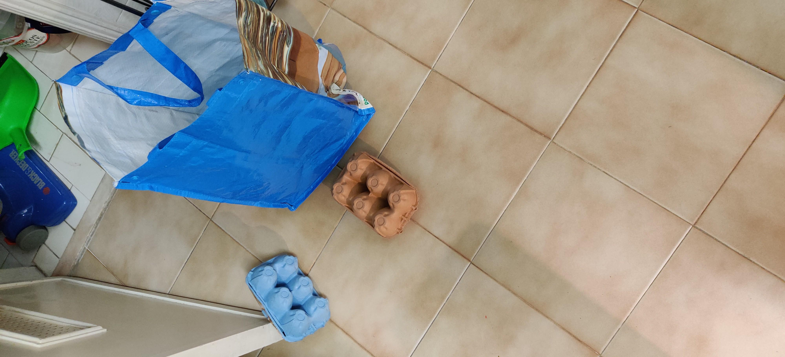
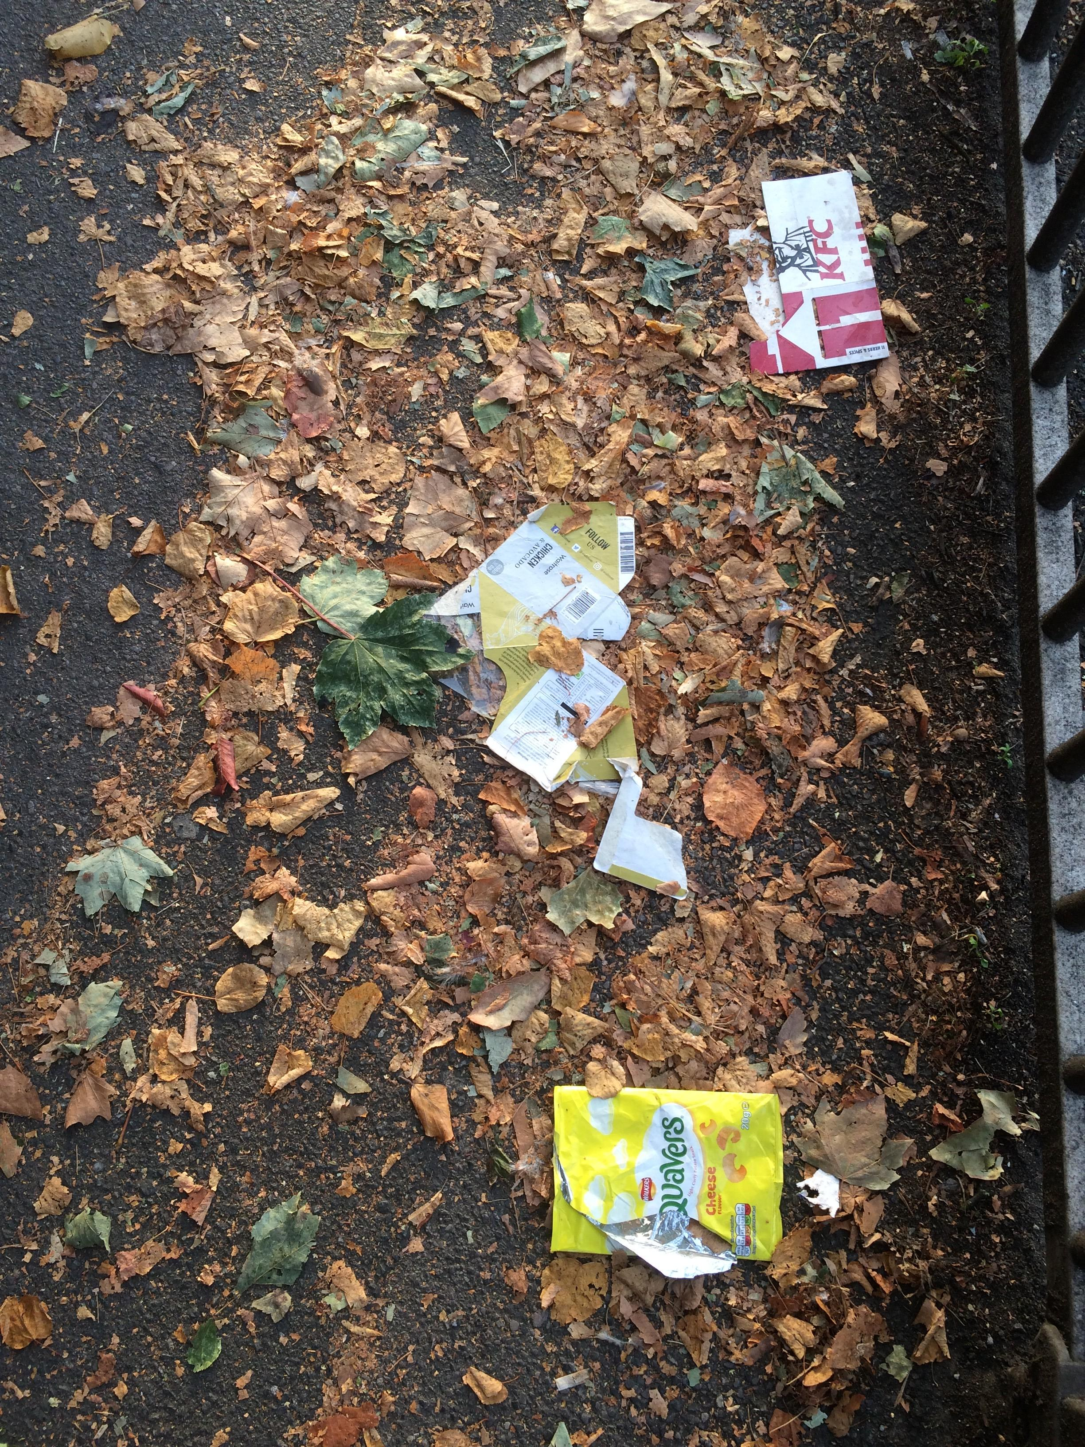
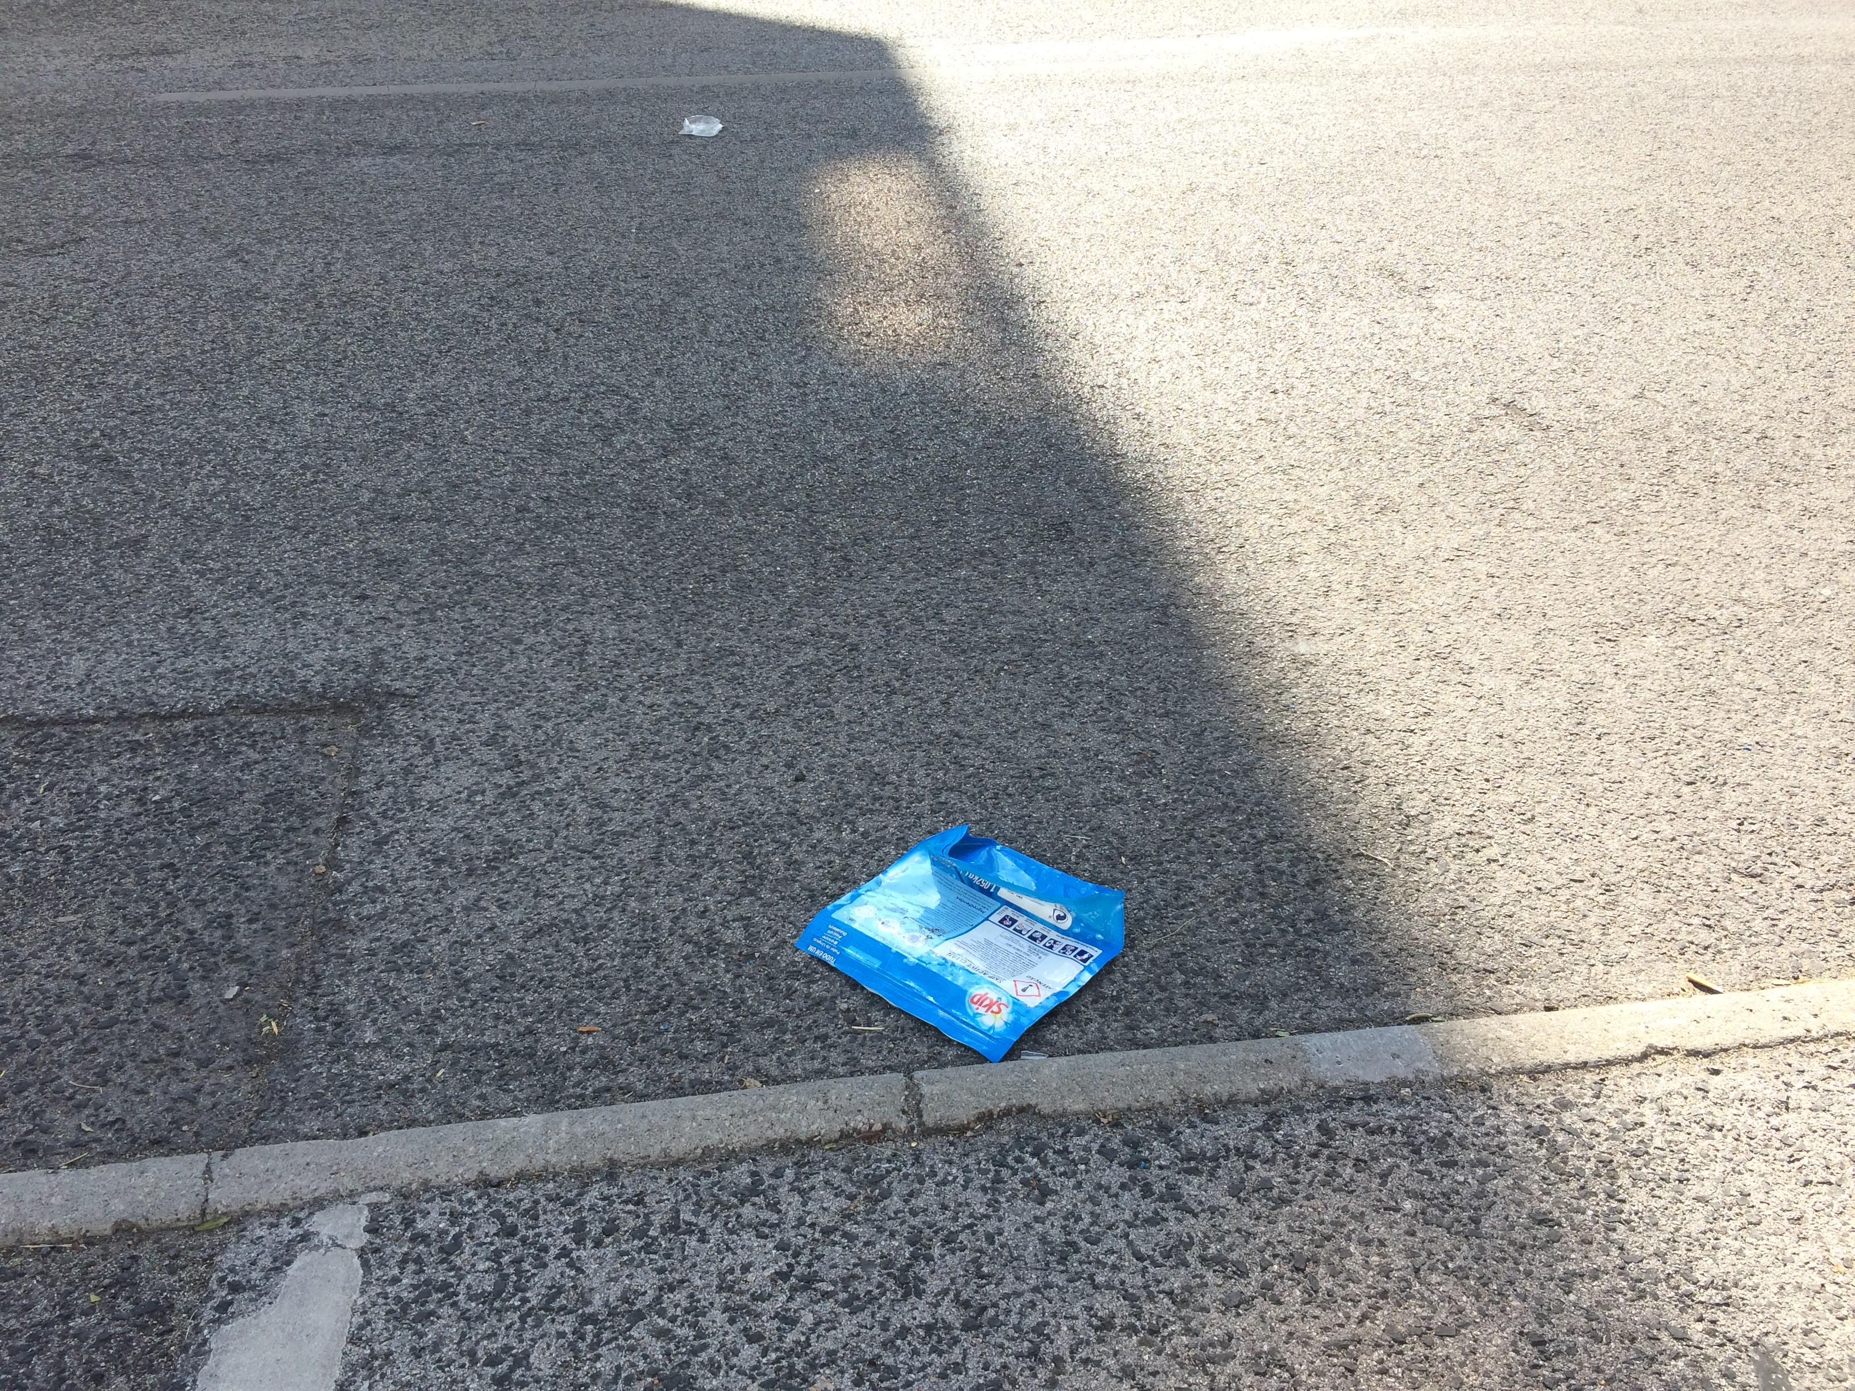
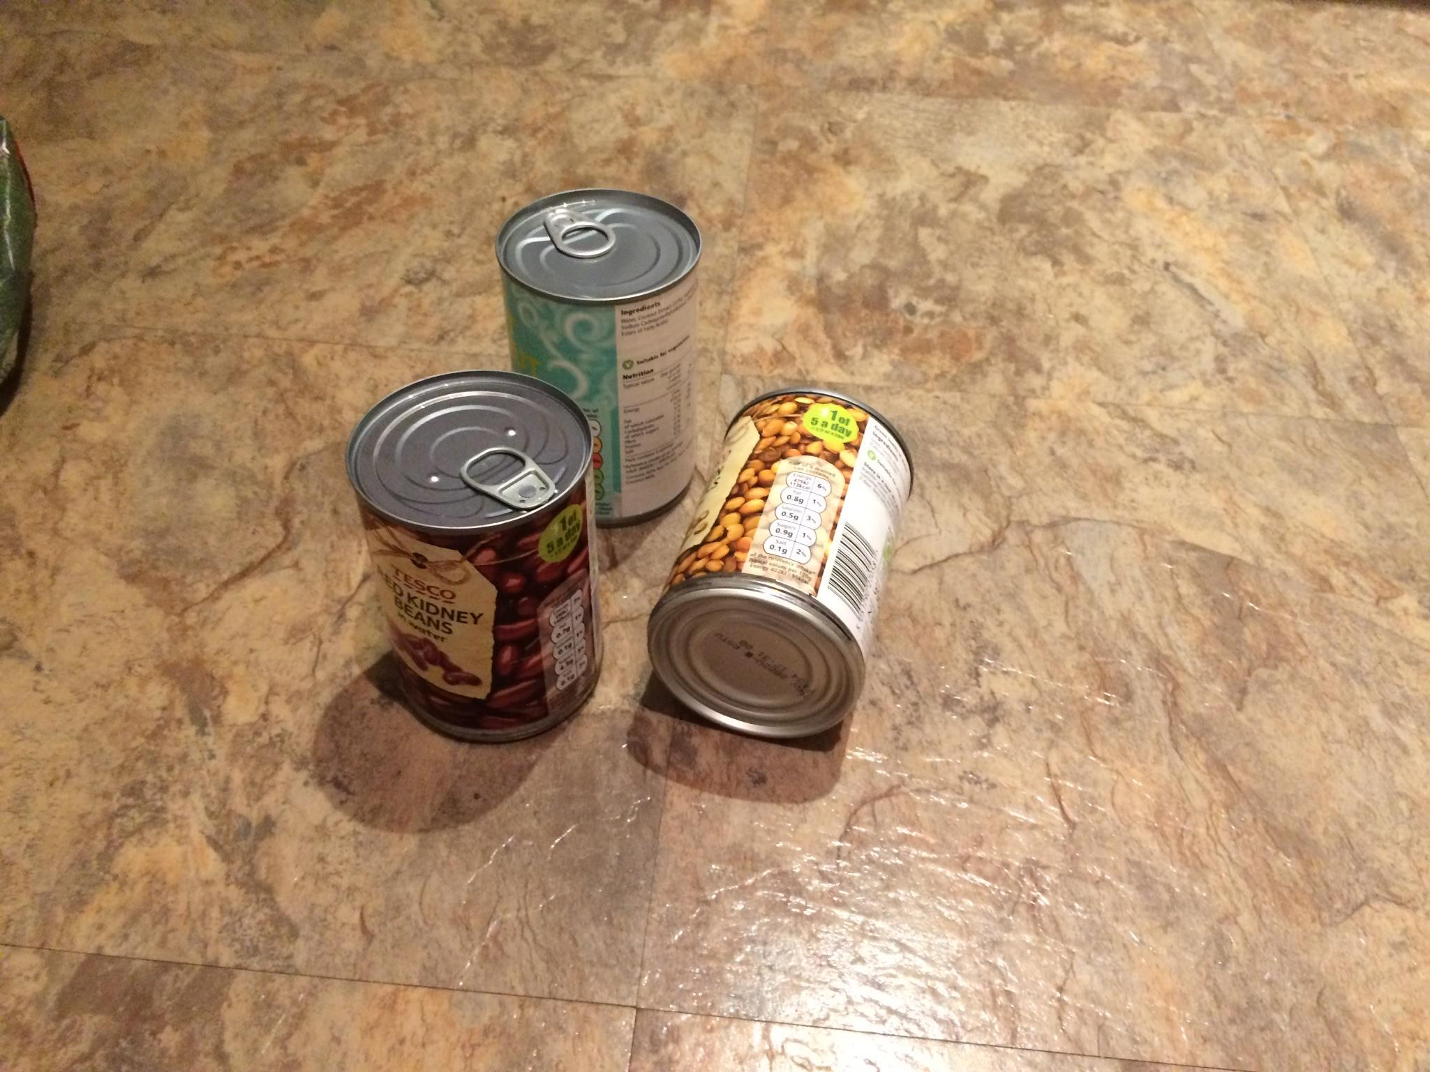
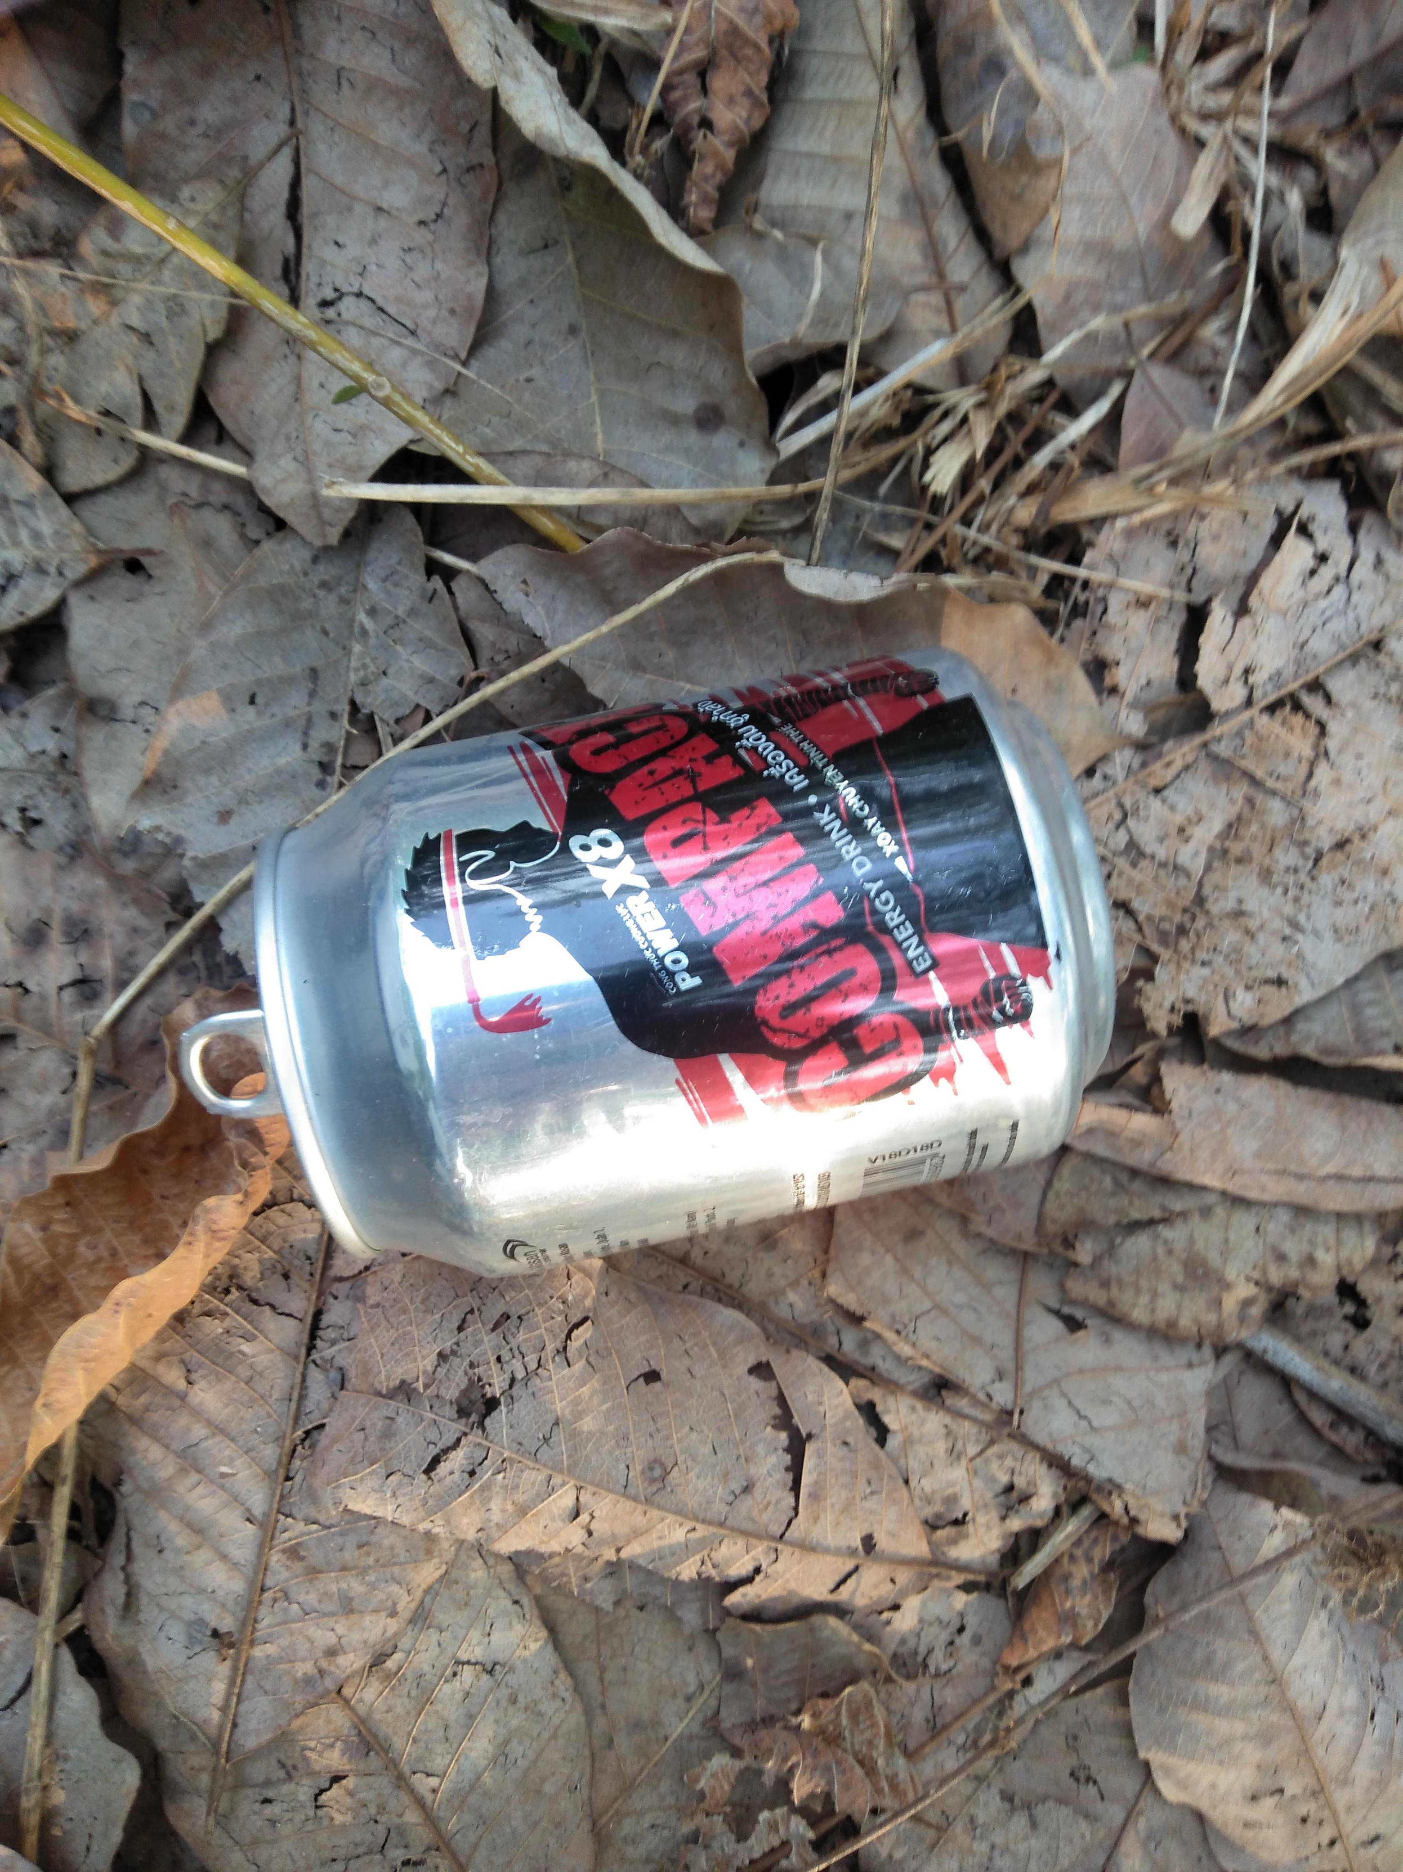
Fig.9, Images present in the TACO dataset

Slide 23
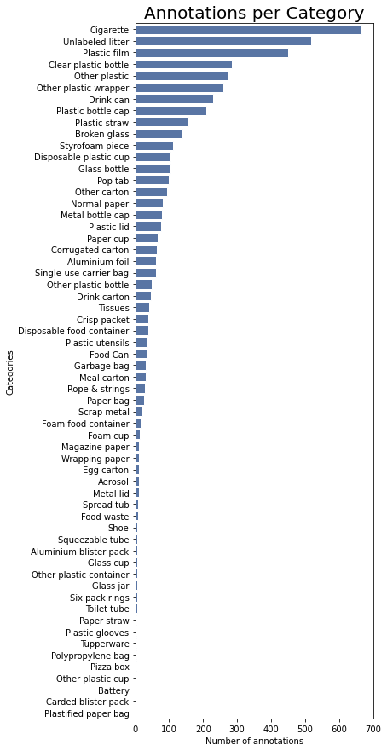
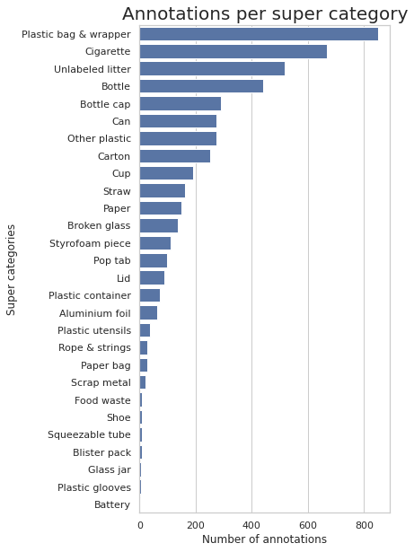
Fig.10, Different classes present in the dataset

Slide 24


PRE-PROCESSING
The Roboflow platform is used mainly for splitting the dataset in train, test and validataion sets and also this platform gives many facilities to pre-process the images such as resize, auto-orient, flip, shear, rotate etc., to generate different samples from original dataset to the training set to learn the model well.
It very much useful for changing the annotations format into many formats such PASCAL, VOC, YOLO, JSON, CSV and TXT, and once pre-processing steps over, we can also train our model in their platform and deploy it as well.

Slide 25
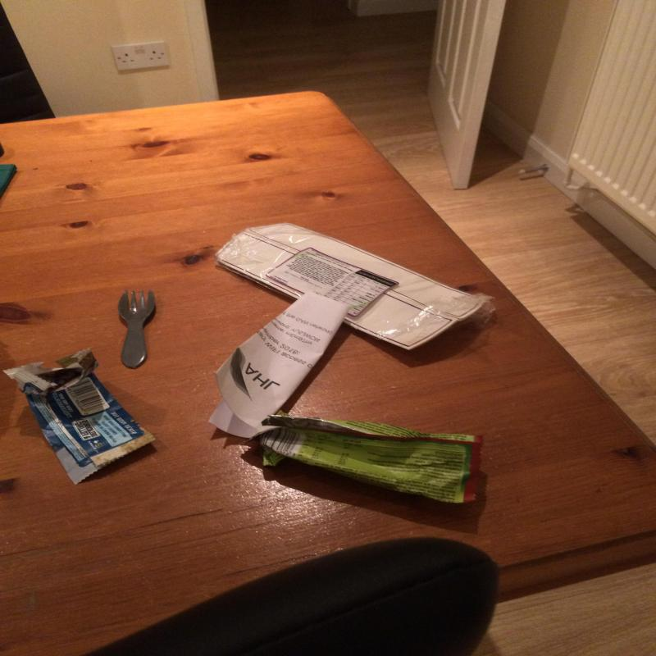
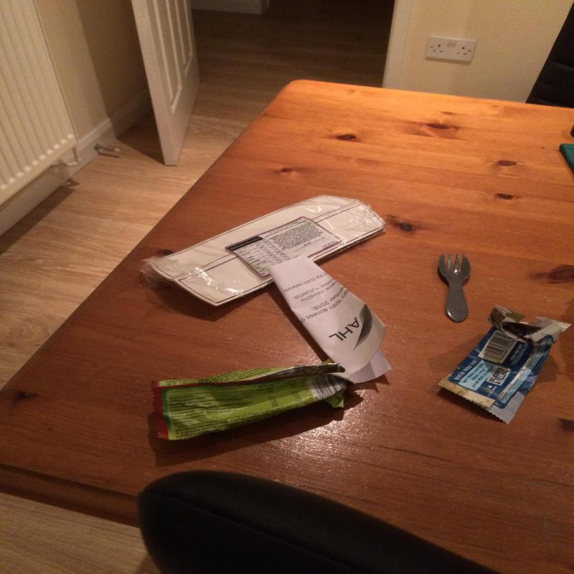
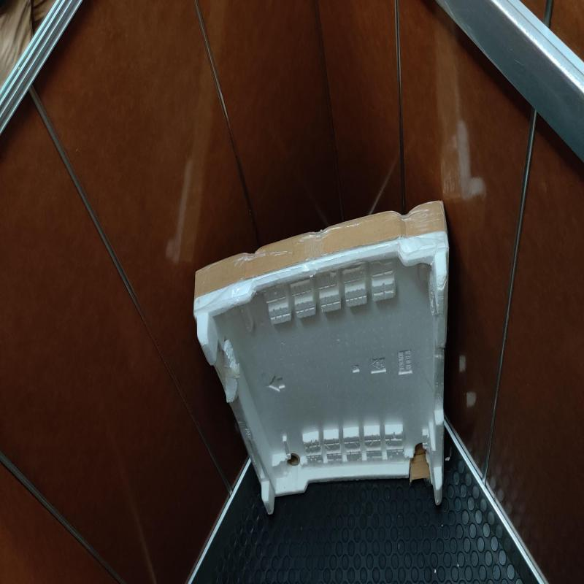
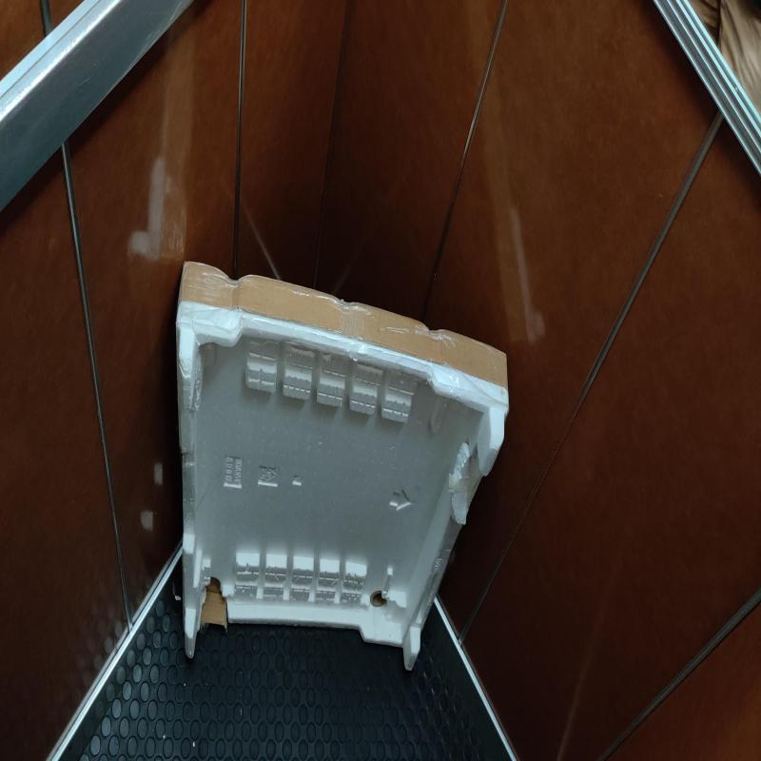
Fig.11, Horizontally flipped images present in the train dataset

Slide 26
MODEL CONFIGURATION
First we have to register the dataset to the Detectron2 Engine to recognize the images and json annotations file contained in the train, valid and test folder.
We use Mask R-CNN architecture in yaml file and set the maximum number of iterations into 5000 for better learning to the model and evaluation period into 500, after every 500 iterations we want to evaluate the validation set side-by-side. The Learning rate has set to 0.001 and we have number of classes set to 60.
Finally define the output directory path to store the metrics file, last check point, and the model as stored in PyTorch format as ‘.pth’.

Slide 27
MODEL TRAINING
The Detectron2 Engine is now configured in default and we only changed the Mask R-CNN architecture hyperparameter. The model is trained on 5000 iterations with 500 evaluation period with the help of NVIDIA Tesla T4 GPU and CUDA supported PyTorch library provided by the Google Colab with 16GB RAM and the total time for the training process was near about 45 minutes.
The value of total loss was initially high during the training process. As the progression of the training occurred the loss value started getting lower. When the training started at first, the value of the initial total loss was near about 5.67 and then the value of the loss gradually dropped to a point at 0.66. And for the class loss was near about 3.975 and dropped finally in the last iteration to 0.208.

Slide 28
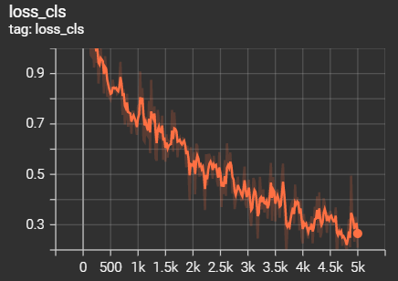
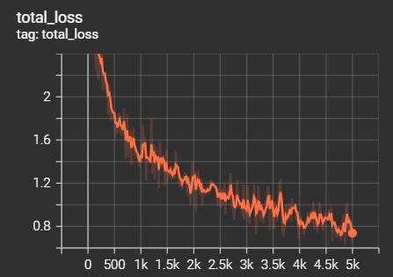
Fig.12, Class loss & Total loss graphs during the training process

Slide 29
METRICS
Average Precision (AP) and mean Average Precision (mAP) are the most popular metrics used to evaluate object detection models such as Faster R_CNN, Mask R-CNN, YOLO among others.

Slide 30
True Positive (TP) — Correct detection made by the model.
False Positive (FP) — Incorrect detection made by the detector.
False Negative (FN) — A Ground-truth missed (not detected) by the object detector.
True Negative (TN) —This is back gound region correctly not detected by the model. This metric is not used in object detection because such regions are not explicitly annotated when preparing the annotations.

Slide 31
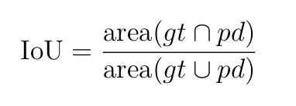
Intersection over Union (IoU)
IoU metric in object detection evaluates the degree of overlap between the ground(gt) truth and prediction(pd). The ground-truth and the prediction can be of any shape as rectangular box, circle, or even irregular shape).

Slide 32
IoU ranges between 0 and 1 where 0 shows no overlap and 1 means perfect overlap between gt and pd. IoU is useful through tresholding, that is, we need a threshold (α, say) and using this threshold we can decide if a detection is correct or not.
For IoU theshold at α, True Positive(TP) is a detection for which IoU(gt,pd)≥ α and False Positive is a detection for which IoU(gt,pd)< α. False Negative is a ground-truth missed together with gt for which IoU(gt,pd)< α.
Consider IoU threshold, α = 0.5 , then TP, FP and FNs can be identified as below

Slide 33
RESULT
In this project, the outcomes of the created model will be examined. The created model works reasonably on the test data. Out of 150 images, 60 – 70 images were quite accurately got predicted by the model which concludes that the Average Precision rate of the model is near about 6.7%.
The model quite precisely classifies the type of waste materials by detecting and segmenting the type of objects.

Slide 34
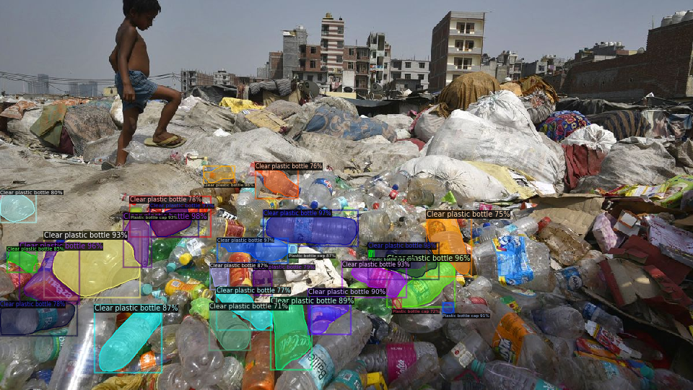
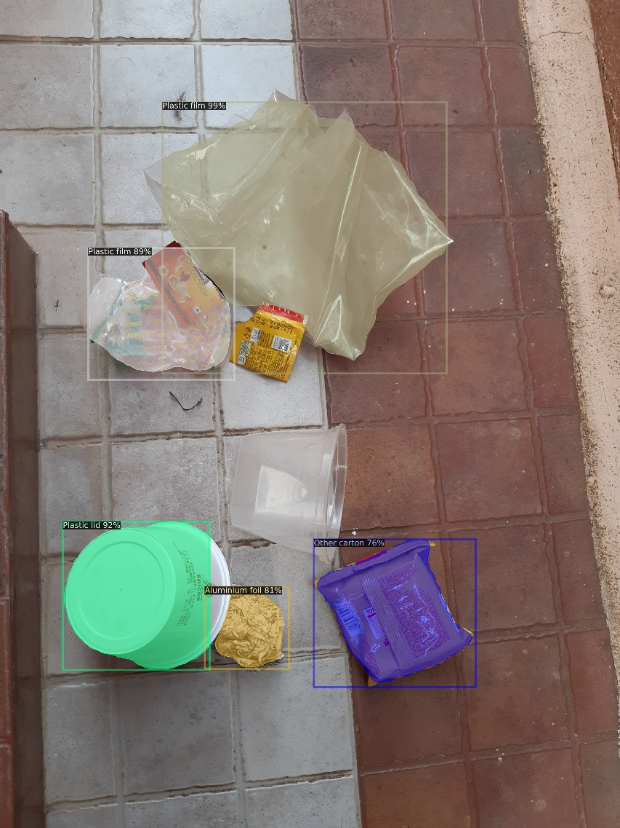
Fig.13, Model’s prediction on unseen images which are predicted and segmented quite good enough.

Slide 35
FUTURE WORK
To use multiple publicly available waste datasets and also try to build own dataset from home, streets, garbage bins, road sides, ponds, lakes, drainages systems, waste management centres
To implement with other object detection algorithms such as YOLO, Single Shot Detector, RetinaNet, and libraries such as ImageAI, GluonCV, Yolov3_TensorFlow
And also to implement it with robotic arms like to classify the wastes in the Waste Management Centres or make surveillance system that identifies a person who throws a waste/trash in clean surroundings.

Slide 36
REFERENCES
Shaoqing Ren, Kaiming He, Ross Girshick, Jian Sun: Faster R-CNN: Towards Real-Time Object Detection with Region Proposal Networks. arXiv:1506.01497
Kaiming He, Georgia Gkioxari, Piotr Dollár, Ross Girshick; Mask R-CNN arXiv:1703.06870
FAIR’s blog on Detectron2- https://ai.facebook.com/blog/-detectron2-a-pytorch-based-modular-object-detection-library-/
Detectron2 - https://github.com/facebookresearch/detectron2
TACO - http://tacodataset.org/
Roboflow platform - https://roboflow.com/

Slide 37
THANK YOU!

